Slide 1
NE 763: Advanced Reactor Materials
Fall 2026
Dr. Benjamin Beeler

Slide 2
Last Time
Intro to course and Gen I to Gen IV reactor concepts
Background and history of HTGRs/TRISO particles
Differences from LWRs
helium cooled; much higher temperatures; thermal/fast options; extensive utilization of graphite; flexibility of fuel
Two geometric types of HTGRs:
Pebble Bed vs Prismatic Reactors

Slide 3
TRISO Particles
TRISO: TRistructural ISOtropic particle fuel
Layered fuel in mm-sized particles
Layers:
Fuel Kernel
Buffer
Inner Pyrolitic Carbon (IPyC)
SiC
Outer Pyrolitic Carbon (OPyC)

Slide 4
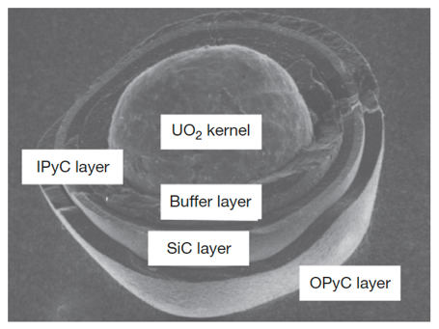
Fuel Kernel + Buffer
A variety of fissile and fertile kernels have been used in particles, including ThC2, ThO2, PuO2, (Th,U)O2, UC2, UO2, and UCO
Nominal fuel kernel diameters range between 100 and 500 microns
The fuel kernel is surrounded by a porous graphite buffer layer that absorbs fission recoils and allows space for swelling and fission gases produced during irradiation
The buffer layer is generally about 100-micron thick

Slide 5
IPyC-SiC-OPyC
Surrounding this inner buffer layer is a layer of dense pyrolytic carbon (IPyC), a silicon carbide (SiC) layer, and a dense outer pyrolytic carbon (OPyC) layer
The pyrolytic carbon layers protect the SiC layer, which is the pressure boundary
The pyrolytic carbon layers are approximately 40-micron thick; the SiC layer is usually about 35-micron thick
Each microsphere acts as a mini pressure vessel, which is designed to impart robustness to the gas reactor fuel system
TRISO diameter is typically ~700 microns

Slide 6
Early Concepts
The concept of nuclear fuel microspheres with refractory ceramic coatings to contain fission products during operation in HTGRs can be traced to the Dragon Project in the 1960s
The earliest versions involved fuel kernels coated with only a single pyrolytic carbon layer intended to protect the kernel during fabrication, this rapidly evolved in the following decade into more complex and more effective particle designs
It was recognized almost from the beginning that the coating layers could provide some degree of advantageous fission product retention when properly designed
(a) BISO particle, (b) Particles with “laminated” pyrocarbon layer structure, (c) Particle with “Triplex” structure, (d) Fertile (Th,U)C2 with of PyC-SiC-PyC structure, (e) Carbide particle with single PyC coating, (f) “Duplex” (Th,U)C2 particle

Slide 7
Early Failure
Fracturing of the pyrocarbon layer in these particles during irradiation was found to be a concern
Causes included kernel swelling, radiation-induced pyrocarbon dimensional change, damage from fission recoils, fission gas pressure, and chemical reaction of fission products with the coating
A design modification was the introduction of a sacrificial layer of pyrocarbon between the kernel and the dense, outer pyrocarbon layer
This two-layered particle design was termed “BISO” for Buffer-isotropic

Slide 8
Transition to TRISO
The notion that refractory ceramics could provide significantly improved particle strength and retention of fission products compared to pyrocarbon alone was suggested near the very beginning of coated particle development
This led to the addition of a silicon carbide layer placed between two layers of dense pyrocarbon
This SiC layer, along with the porous buffer layer of BISO particles, formed the basis for the modern TRISO coating design

Slide 9
Brief Review
TRISO layers and their functions…
Fuel kernel:
the fuel! does the fission stuff
Buffer layer:
allows for isotropic particles, allows fuel swelling and gas release without excess layer stresses
IPyC:
protects SiC from internal fission product attack, also puts SiC into compression
SiC:
primary fission product barrier and pressure vessel
OPyC:
protects SiC layer during manufacturing, also puts SiC into compression

Slide 10
fuel kernel

Slide 11
Fuel Kernel
Coated particle fuel allows flexibility in kernel material
The porous buffer layer mechanically decouples the kernel from the outer coating, allowing for some degree of kernel swelling
Choice of kernel material is influenced by fabrication concerns, kernel behavior under irradiation, and reactor design
Early designs primarily included fertile carbide fuels (ThC)
Carbide kernels have excellent high-temperature compatibility with the surrounding graphite fuel elements
However, oxide kernels simplify the overall fabrication process (don’t have to worry about oxidation) and maintain better chemical stability during the high temperature heat treatment of fuel pebbles during manufacture

Slide 12
Fuel Chemistry
An important consequence of UO2 fission is the creation of free oxygen since only a part of the O2 recombines with the fission products
In the TRISO particle, a portion of this free oxygen combines with carbon from the buffer/PyC coatings to form CO and CO2 gases
Identification of those compounds (solid and gaseous) that can form in fuel during normal and off-normal conditions and which elements remain in elemental form, is fuel chemistry
Changes in fuel chemistry may lead to many important mechanisms affecting fuel performance, e.g., kernel size (swelling), kernel migration (amoeba effect), stresses in the coatings (particle pressurization due to fission products and carbon oxide gases), thermal conductivity, creep properties modification, etc.
The oxygen potential, the partial pressure of oxygen in the gas phase within the fuel, is the critical parameter determining which elements in their competition for oxygen form oxides

Slide 13
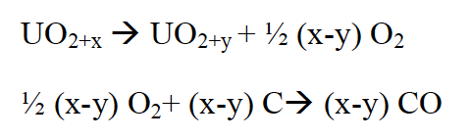



Oxygen Potential
Calculation of the oxygen potential is complex since it generally varies with distance from the particle center and with temperature, fuel burnup, fission product yields, chemical state of fission products including solid and gas phases, and the effectiveness of the coating layers to absorb fission products and oxygen
The oxygen potential is represented by:
where P(O2) is the oxygen partial pressure, R is the gas constant, T is the temperature
In fresh fuel (simpler case), where we assume the fuel reaches thermodynamic equilibrium with its surrounding coatings, the main product of the reaction between UO2+x (x>0) and carbon is gaseous carbon monoxide, CO, by the following reactions:
which can be rearranged as:
Utilizing an equilibrium rate constant K,

Slide 14
Oxygen Potential
Reactions to generate CO2 are also possible, but at applicable temperatures and values of the oxygen potential, CO production dominates
As the oxygen potential, i.e., oxygen partial pressure, is increased we are generating more CO
The result of CO formation is internal pressurization of the particle which may lead, in extreme conditions, to particle failure
To limit this pressurization, other fuel kernel concepts have been and are being studied, of particular interest is the oxycarbide fuel (or UCO) comprising a mixture of UC2 and UO2
Gas formation is effectively reduced within the UCO particle as compared to a UO2 particle due primarily to their lower oxygen inventory
Additionally, there is a gettering effect of the UC2 on the oxygen released during UO2 fission which forms a condensed oxide rather than CO gas

Slide 15
CO Pressurization
The result of CO formation is internal pressurizing of the particle that increases with burnup and adds to the pressurization from fission gases
At lower burnup (≤ 6 % FIMA), pressurization of the particle arises principally from fission-gas release from the fuel kernel
At higher burnup (9% FIMA, at 1450 K), the pressure resulting from fission gases can represent half of the contribution of CO in an HTGR TRISO coated particle
CO pressurization dominates at high BU
The suppression of excessive CO formation during oxidation of a UO2 based particle remains an important design objective at moderate and high burnup
The failure of the SiC layer may happen because of over-pressurization due to CO formation
CO pressures are suspected of being partly responsible for the mechanical weakening of the IPyC coating
Corrosion of the SiC layer by CO can occur as a result from failure of the IPyC coating

Slide 16
Uranium Oxycarbide (UCO)
European TRISO still largely focused on UO2 fuel kernels
Work in the US retained the carbide kernel design, because the HTGR designs of required high peak fuel temperatures, high burnup, and high power densities that would result in excessive kernel migration
With UC fuel, no worries about CO production
However, it was found that rare earth fission product elements migrating from carbide kernels during irradiation could chemically attack the SiC layer of TRISO particles and compromise the structural integrity
FP Attack

Slide 17
UCO
We have two fuel kernel problems:
CO production (UO2)
fission product release (UC)
This led to the suggestion of a kernel comprised of a mixture of both oxide and carbide phases
Thus, a design was made to include sufficient UC2 to getter the excess oxygen produced by UO2 fission
UCO avoids the formation of CO, while still taking advantage of the retention of the metal oxide fission products in the predominantly UO2 kernel
The success of UCO kernels by the US program led to the adoption of UCO fuel as the reference fissile particle design by the early 1980s, with a UO2/UC2 mixture of about 80/20

Slide 18
Interlude…
Oxygen potential
UO2 and UC kernels
CO production
Fission product release/attack
UCO kernels
Questions…?

Slide 19
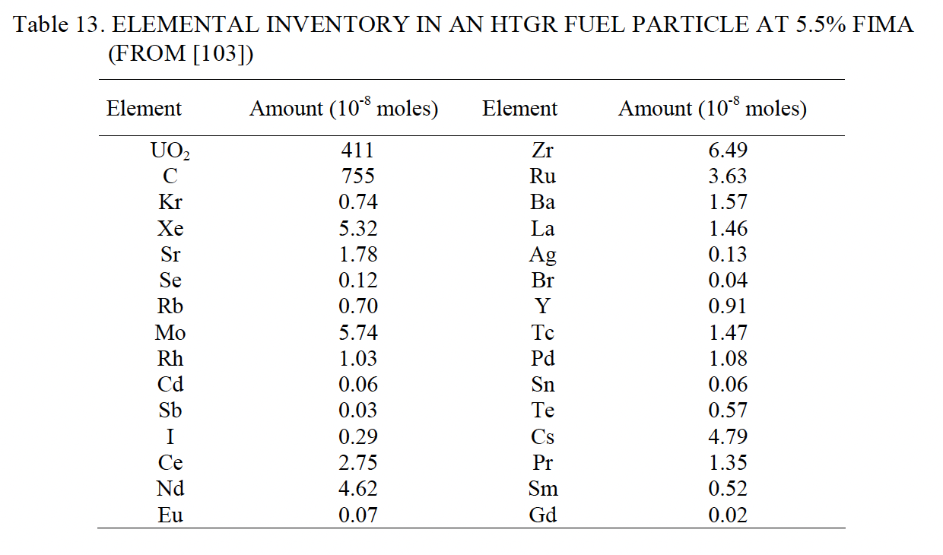
Fission Products
The rate of change of each nuclide is a function of three processes:
depletion of heavy nuclei by fission and corresponding production of lighter nuclei (fission products)
production by radioactive decay (actinides and fission products) and/or by neutron capture (actinides)
loss by radioactive decay (actinides and fission products) and/or by neutron capture (actinides)
Element inventory for a UO2 kernel @ 5.5% FIMA on the right
IAEA-TECDOC-1645

Slide 20
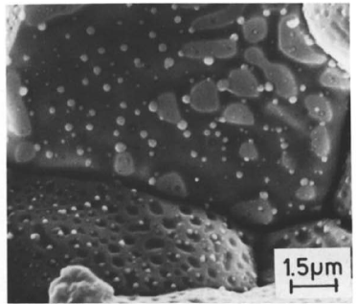
There are various types of fission products that form
Soluble oxides (Y, La and the rare earths)
Dissolved in the cation sublattice
Insoluble oxides (Zr, Ba and Sr)
Form insoluble oxides in the fluorite lattice
Metals (Mo, Ru, Pd, and Tc)
Form metallic precipitates
Volatiles (Br, Rb, Te, I and Cs)
Exist as gases at high temperatures of the pellet interior
Also exist as solids at the cooler pellet exterior
Noble gases (Xe, Kr)
Essentially insoluble in the fuel matrix
Form either intragranular (within grain) voids or bubbles or intergranular (grain boundary) bubbles

Slide 21
Fission Products
Fission products in UO2 are primarily located as substitutional atoms, commonly paired with additional vacancies
A large number of fission products are highly insoluble in UO2, including Xe, I, and Br
Some solubility exists for transition metals such as Zr and alkaline metals such as Sr, and high solubility exists for some rare earth elements, such as Ce
Fission products in the fuel lattice can diffuse out of the UO2 to grain boundaries
The diffusion mechanism depends on the nature of the fission product trap sites and on the fission product intrinsic characteristics
Irradiation effects can greatly enhance or reduce this diffusion by trapping mechanisms on extended defects

Slide 22
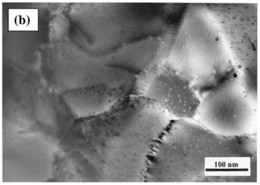
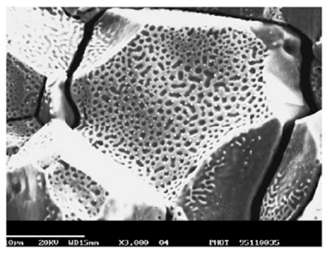
Fission Products
The fission gases precipitate primarily as intragranular bubbles which can grow by gas-atom and vacancy absorption
Fission gases can migrate to grain boundaries by atomic or bubble diffusion to form intergranular bubbles where they can grow by addition of gas and vacancies
Fission-rate helps to strongly limit bubble size and maintain a substantial fission-gas atom population in the fuel lattice by re-solution of gas from bubbles
Once intergranular-bubble growth becomes significant causing interconnection of porosity, a path from within the kernel to the buffer is created leading to fission-gas release by a percolation mechanism – 3 stage gas release

Slide 23
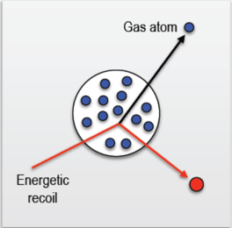
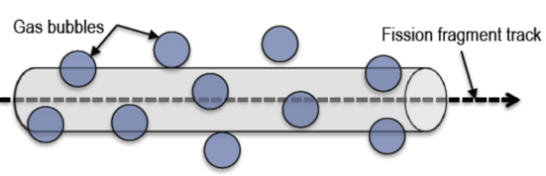
Bubble Resolution
Homogeneous resolution
individual gas atoms are ejected from the gas bubble through collisions with energetic fission fragments or recoil uranium atoms
Heterogeneous resolution
bubble are almost completely destroyed by the passage of a fission fragment

Slide 24
Fission Product Chemistry
Rare earth elements have high solubility in UO2 and form rare earth oxides (REOs)
Zr, Nb and Sr have significant solubility in UO2 and oxidize to form ZrO2, Nb2O3 and SrO
Fission products that either have lower solubility or are less likely to form stable oxides, such as Ba, Te and Mo, diffuse to the grain boundaries and form perovskite or intermetallic precipitates
These grain boundary inclusions can allow for release from the fuel kernel
Ag and Pd are known to form intermetallic precipitates and are readily release from the fuel kernel
Ellingham diagram showing the temperature dependence of the stability of compounds

Slide 25
Fission Product Carbides
In the UCO-type fuel kernel, oxygen liberated during the fission process of UO2, first oxidizes the carbide UC2 phase and then the RE fission products because of their high affinity for oxygen
Those fission product elements with lower affinity for oxygen (Sr, Eu, Zr, Ba) exist as carbide compounds
As the burnup increases, the UC2 phase in the kernel decreases
When UC2 has fully disappeared, the oxygen potential then increases, and oxygen is available to form oxide compounds with these fission products
Oxidation diagram for carbides of interest

Slide 26
Fuel Kernel Summary
Flexible composition, allowing for commercial power, fertile, breeder, and burner options; mainly carbide and oxide options
Carbides allow for higher power density and higher temperatures, reduce CO production
Oxides retain fission products, easier to fabricate
US utilizes UCO 80(UO2)/20(UC2) mix
UC2 gets oxidized, then other fission fission products will form oxides
Five different fission product groupings – main fuel is UO2, similar behavior to UO2
Will cover some other fuel kernel related failure mechanisms later

Slide 27
Silicon Carbide

Slide 28
Silicon Carbide (SiC)
SiC is a very hard and strong non-oxide ceramic that possesses unique thermal and electronic properties
Polycrystalline SiC has a strength of 15 GPa and has excellent creep resistance
SiC’s upper limit of stability is around 2500C and has a melting temperature of around 2830C
SiC also has excellent thermal conductivity
SiC is a highly covalent material that forms tetrahedra that are centered around either carbon or silicon atoms
β-SiC takes the diamond cubic structure with half of the carbons being replaced with silicon; this is a very stable structure that is conducive to phononic heat conduction

Slide 29
Silicon Carbide (SiC)
Silicon carbide (SiC) has been studied and utilized in nuclear systems for decades, primarily as the micro pressure vessel for high-temperature gas-cooled reactor fuels
The SiC must be strong enough to withstand the pressure buildup from the fission product gas liberated and CO produced
The SiC layer must withstand chemical attack from metallic fission products such as palladium
The SiC must be able to handle the mechanical loads derived from irradiation-induced dimensional changes occurring in the PyC layers
The SiC must maintain its properties during irradiation

Slide 30
Radiation Effects in SiC
The neutron-induced swelling of SiC has been well studied for low and intermediate temperatures (up to 1000 C)
It is well understood that the presence of significant second phases and/or poorly crystallized phases in these materials leads to unstable behavior under neutron irradiation
High purity, stoichiometric, near-theoretical density SiC can show excellent radiation resistance
Here I will be talking about the good SiC, assuming that the fabrication process has produced appropriately clean coatings

Slide 31
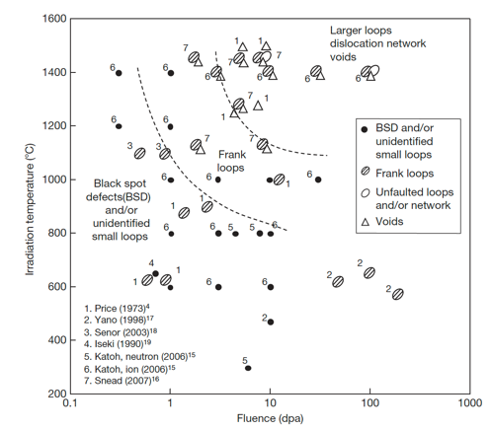
Radiation Effects in SiC
The microstructural evolution map is shown on the right
Different types of defects form at different temperatures
Swelling behavior of SiC is relatively well understood
But the contribution of the defects themselves to the swelling in SiC is not well understood

Slide 32
Low T Radiation Effects in SiC
Below 400 K, neutron irradiated SiC microstructure is described as black spot defects, which are most likely clusters of self-interstitial atoms
For irradiation temperatures less than about 423 K, accumulation of strain due to the irradiation-produced defects can exceed a critical level above which the crystal becomes amorphous
The swelling under self-ion irradiation increases logarithmically with dose until amorphization occurs
The swelling of neutron- and ion-amorphized SiC has been reported to be as high as 10.8% at 343K

Slide 33
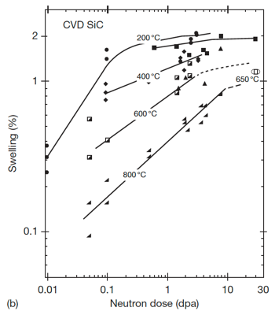
Low-Med T Radiation Effects in SiC
Above the critical amorphization temperature (423 K), the swelling increases logarithmically with dose until it reaches saturation
The saturation level decreases with increasing irradiation temperature
The dose exponents of swelling during the log period are often close to 2/3, in line with assumptions based on interstitial clusters
This temperature regime is referred to as the point-defect swelling regime and goes from critical amorphization temperature to about 1273 K

